Slide 1

Applying MotionUI Concepts in BFSI Domain
Team Name : Nossh

Slide 2
Idea
The idea is to create a lite version of a bank website to only show a few important details of the account holder. The user will be able to check details of their subscribed plans.
We are creating a login page where the account holder enters their credentials.
We are creating a page which will be seen by the account holder when the user logs in using the bank’s credentials.
The page will showcase various bank services through an attractive interface. Services such as access to transactions to debit card details. All show in pictorial format.

Slide 3
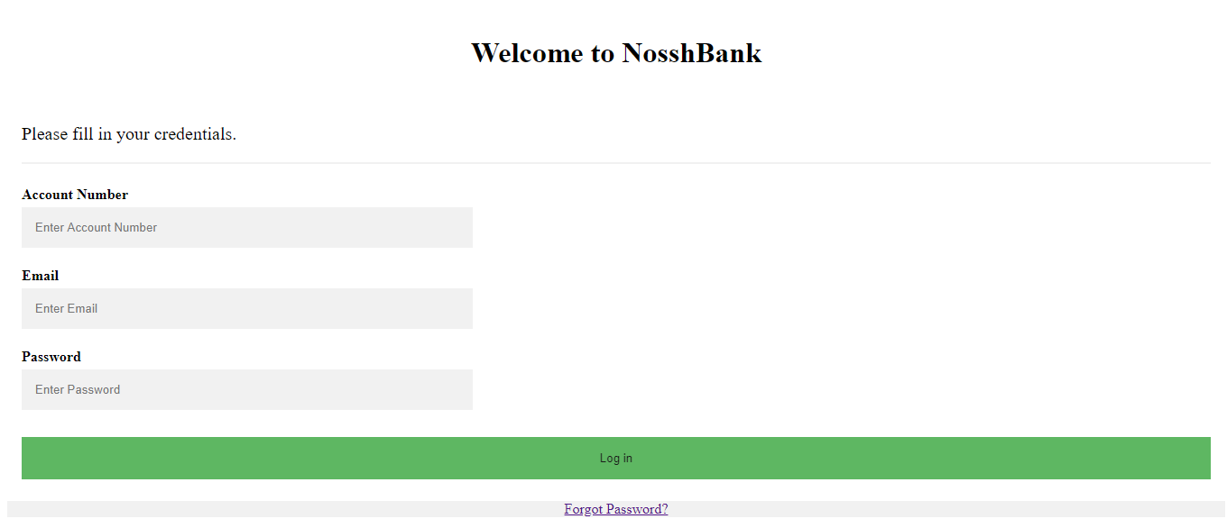

Slide 4
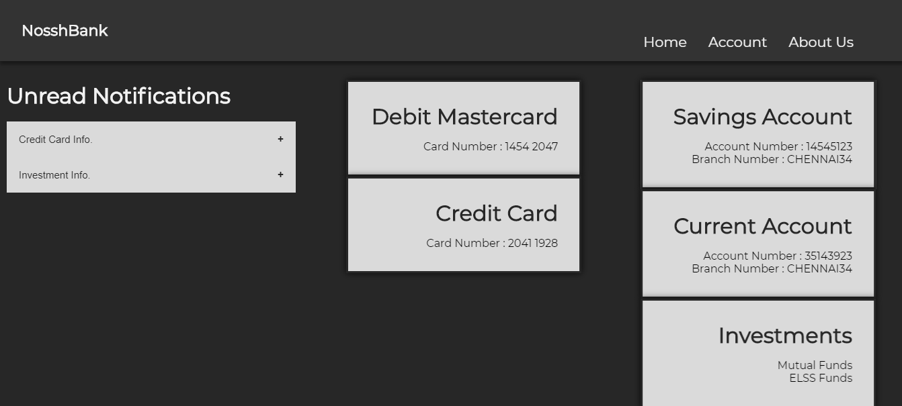

Slide 5
Idea
We are inserting a ticket checking service which will be used to track a query which is raised by the user.
In addition to the ticket status service, we have provided feedback forms which can be used to get feedback to further understand what our customers require, and more importantly, what they want.

Slide 6
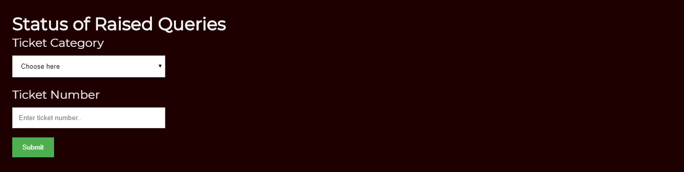

Slide 7
Thank
You

